Slide 1
Used car price prediction
TEAM MEMBERS: RAGURAM M
RAM SUNDAR S
MAHADEV M

Slide 2
Outline
Objective
Architecture diagram of the proposed system
List of modules
Module description ( Each module must be described with techniques, algorithms, and Results)
Results with Comparisons and Inference

Slide 3
Objective
The objective of a used car price prediction project is to develop a model that can accurately estimate the prices of used cars based on various factors and features.
a predictive model that can assist buyers, sellers, and stakeholders in making informed decisions regarding the pricing of used cars.

Slide 4
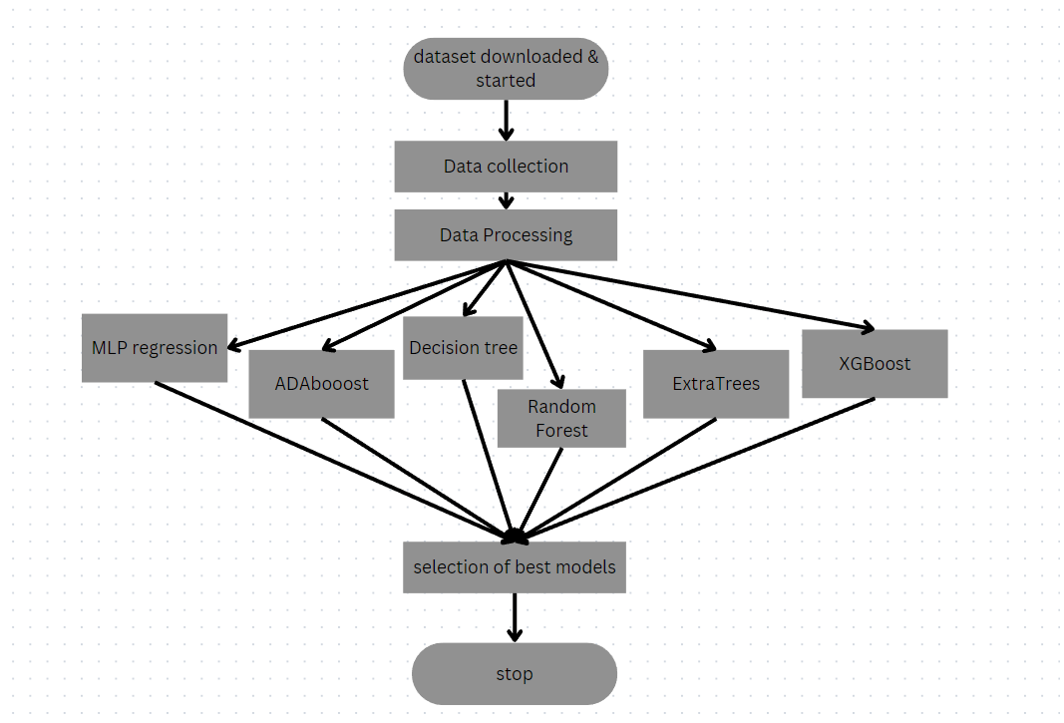
Architecture diagram of the proposed system

Slide 5
List of modules
Encoding Categorical Variables
Scaling and Normalization
Linear Regression
Random Forest
Gradient Boosting

Slide 6
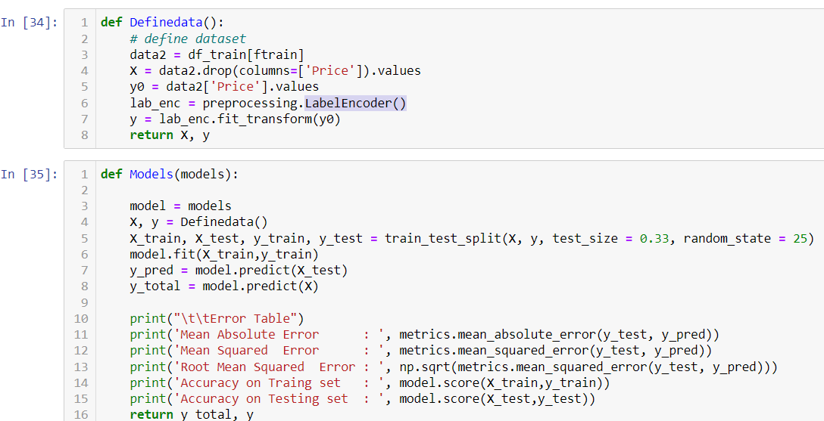
Encoding Categorical Variables
Use techniques like one-hot encoding, label encoding, or target encoding using functions like get_dummies() or LabelEncoder() from the sklearn.preprocessing module.

Slide 7
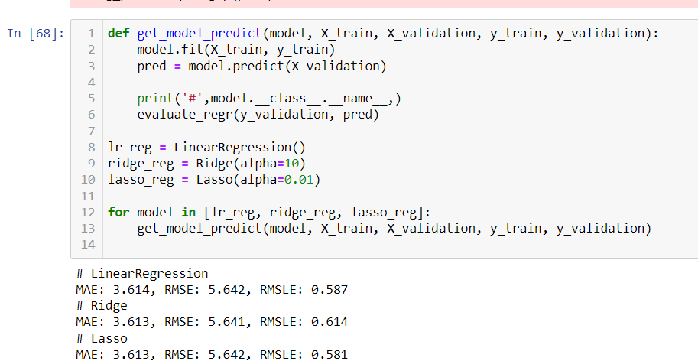
Scaling and Normalization & Linear Regression
Scale numerical features to ensure they are on a similar scale, preventing dominance of certain features during model training.
Linear regression is a basic yet effective algorithm for predicting continuous values. It models the linear relationship between the input features and the target variable to estimate the prices of used cars.

Slide 8
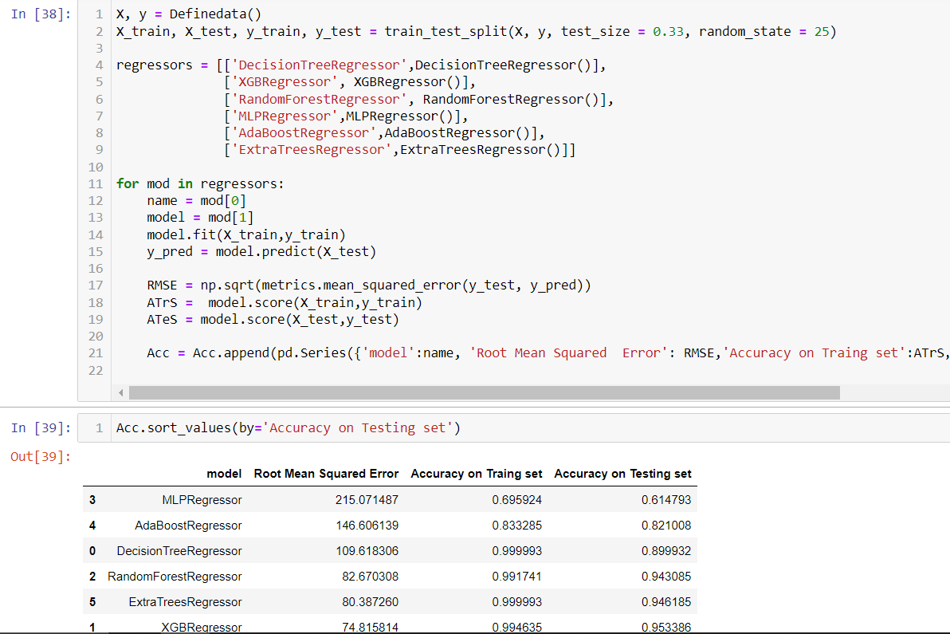
Random Forest & Gradient Boosting
Random Forest is an ensemble method that combines multiple decision trees to make predictions
Gradient Boosting is another ensemble method that sequentially trains weak models (e.g., decision trees) and combines their predictions to form a strong predictive model

Slide 9
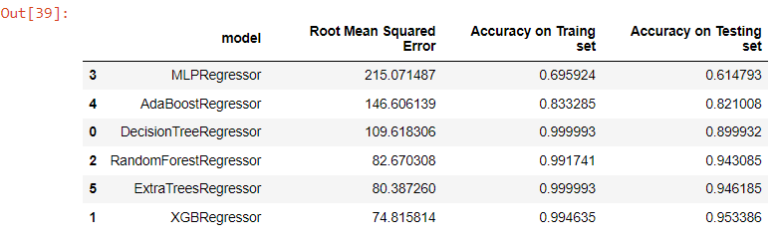
Results with Comparisons and Inference
By considering all four metrics it can be concluded that XGBoost the best model for the prediction for used car prices XGBoost as a regression model gave the best MAE, MSE and RMSE values .

Slide 10
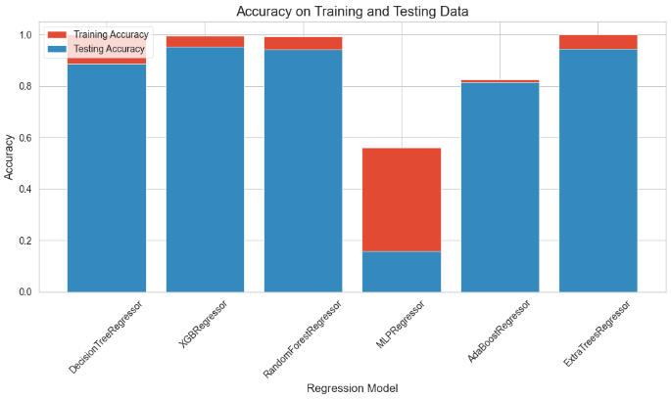
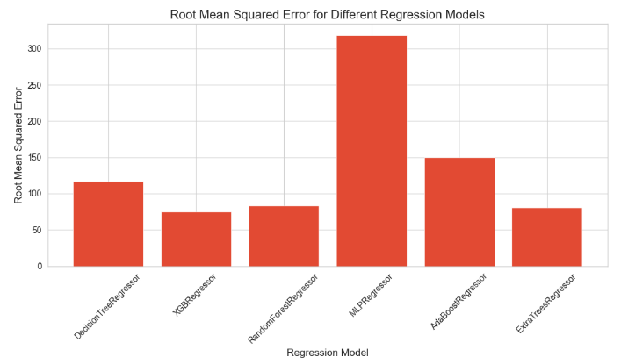
Plots and graphs on results

